Slide 1


SQL Murder Mystery: “Who Killed the CEO?”
The CEO of Tech Nova Inc. has been found dead in their office on October 15, 2025, at 9:00 PM.
I’m lead data analyst tasked with solving this case using SQL.
Keycard logs
Phone call record
Alibis
Evidence found in different rooms
Naveen R S

Slide 2

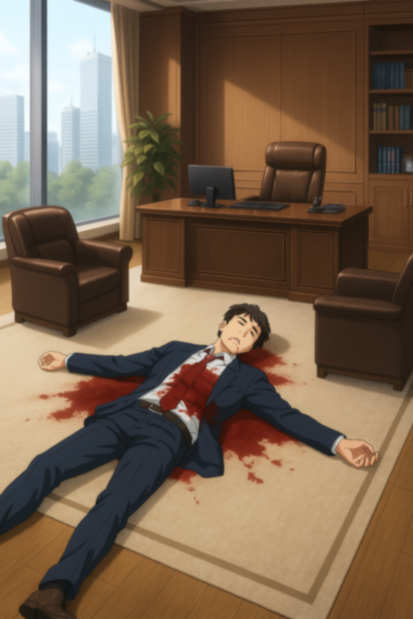
Who entered the CEO’s Office
close to the time of the murder ?
David Kumar entered the CEO’s Office at 20:50, right before the murder.
He remained there until 21:00, making him the only person present at the time.

Slide 3
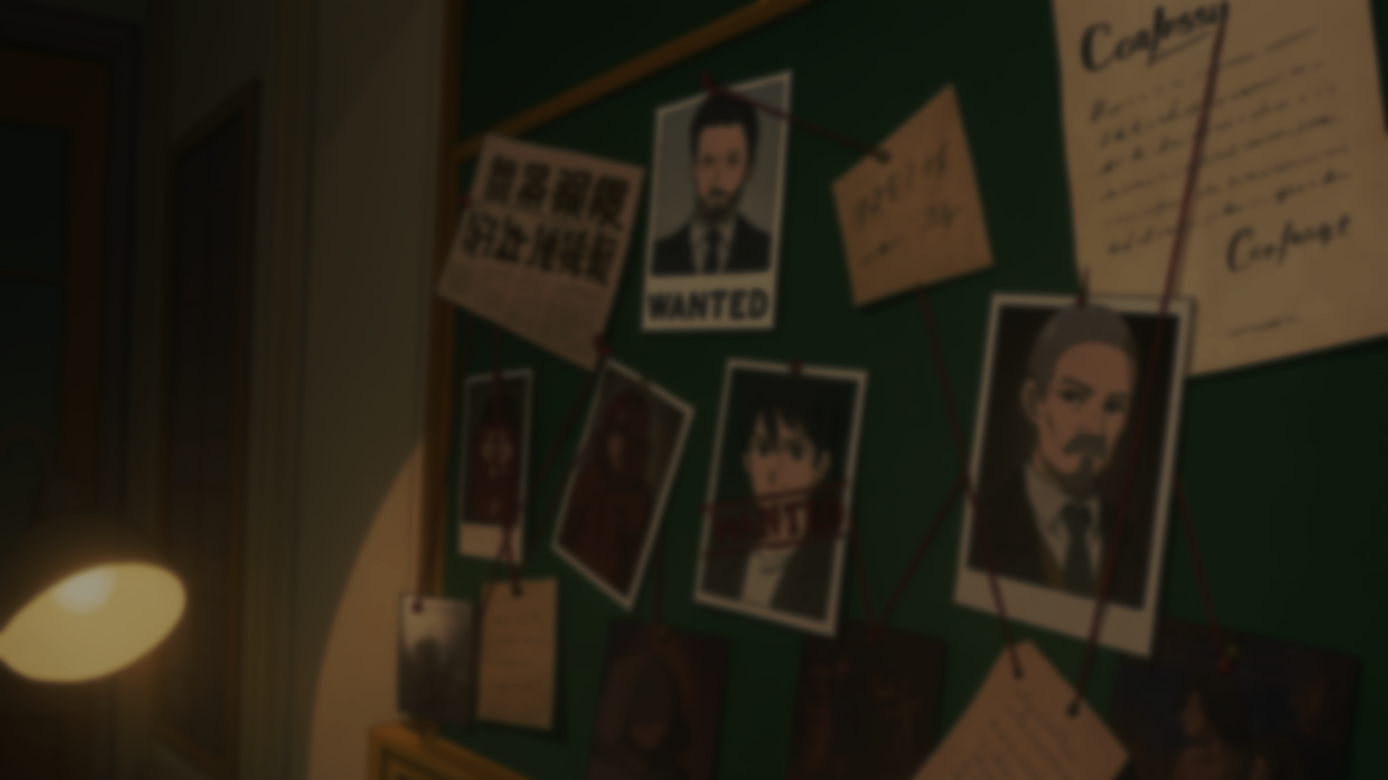
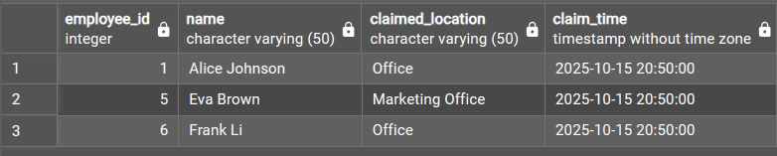
Who claimed to be somewhere else but was not?
Use JOIN
to connect tables like employees
and keycard_logs

Slide 4
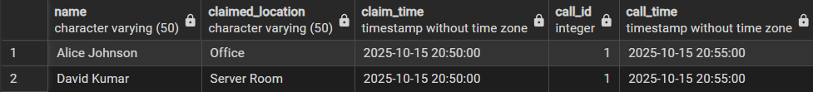
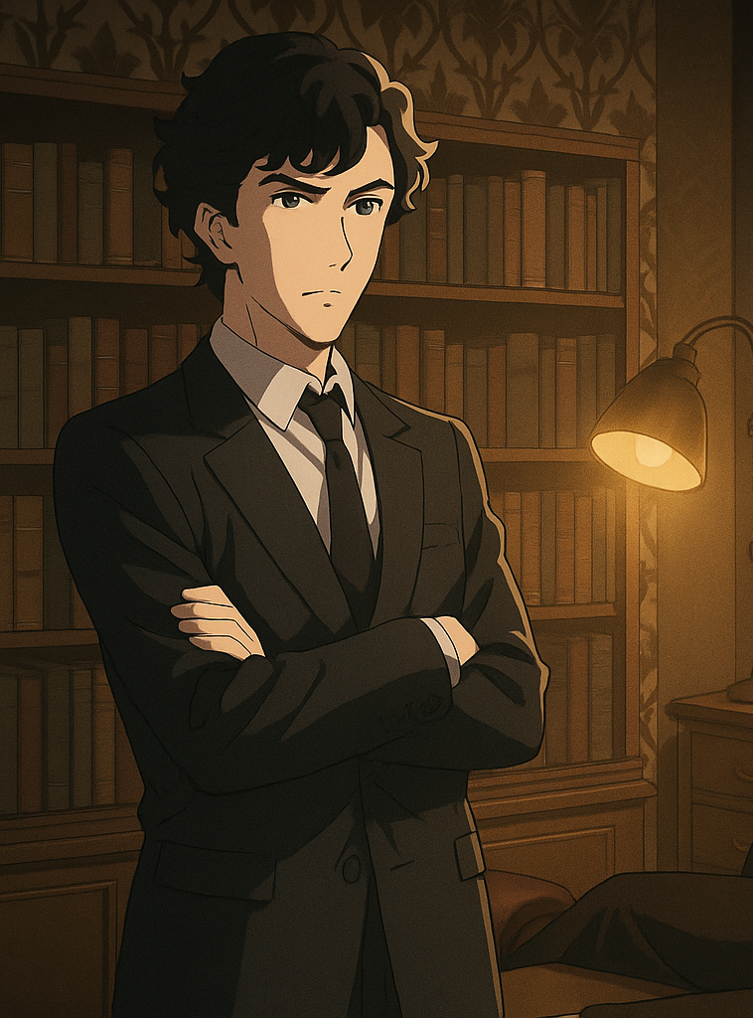
Who made or received calls around 20:50–21:00?
Cross-check alibis with actual
logs JOIN, subqueries
Alice Johnson and David Kumar were
involved in a call at 20:55,
placing both in communication
during the critical 20:50–21:00 time window.”

Slide 5

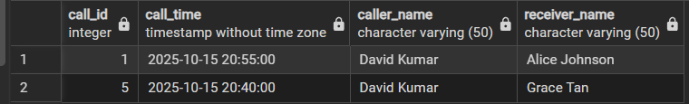
What evidence was found at the crime scene?
At the crime scene in the CEO’s Office,
investigators found a fingerprint
on the desk and keycard log mismatches,
pointing to suspicious unauthorized access.”

Slide 6
Which suspect’s movements, alibi, and call activity don’t add up?
David Kumar’s story collapses—he was in the CEO Office at the murder time,
claimed he was in the Server Room, and made a call at 20:55, exposing false alibis.

Slide 7




David Kumar is the killer because:He was the only person present in the CEO Office at the time of the murder.He lied about his location, providing a false alibi.Call logs show he was active inside during the murder.Evidence at the scene directly matches him.All data points—movements, calls, alibi, and physical evidence—converge on David Kumar as the murderer.

